Slide 1

Virtual classroom analysis for ADHD screening
Capstone Project Phase B
Project code: 23-1-D-21
Meitar Sasson
Shimon Elkobi Supervisor:
Dr. Anat Dahan

Slide 2
Table of Contents
01
02
03
04
Problem & Solution
Product
Development Process
Result & Sample

Slide 3
Problem & Solution

Slide 4
The Problem
Common disorder
Artificial diagnoses
Lack of information
ADHD is regarded as one of the most common childhood disorders
The computerized tests are artificial and do not simulate the daily challenges
The information about the nature of the disorder for the specific child is limited.

Slide 5

Our Solution
Expand ADHD diagnostic tools.
Provides an indication of whether the subject is suspected of ADHD based on the test results.
01
02
03
Individual and group performance analysis.
04
Reflect the findings with the subject.

Slide 6
Product

Slide 7

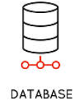



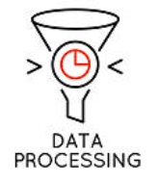


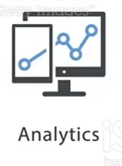


ADHD expert
Product
Perform the ADHD screening
Notes:
The experiment participants perform a test on the external system, from which we export the result files. We upload the result files to our system, analyze the data, select the appropriate ones and process them, train a classification type machine learning model and finally present the data with the help of graphs and analytics that can be used by the experts in the ADHD field for research in the field or for providing an initial diagnosis to the subject who performed the test. The three types of system users are: the test subjects, who can register in our system only if they have taken the test in the external system, and will be able to view their results. The software developer, that he can add more user results in the future, train the model and refine it. and the ADHD expert.

Slide 8
Development Process

Slide 9
Our Process
Learning the virtual classroom system and perform the expriment
Model training with XGBoost algorithm
1
2
3
4
Data analysis
Users interfaces implementation

Slide 10
The experiment
We performed the experiment on ten people.
We told them the instructions for the user, which we got from the students who developed the system.
We exported from the system an Excel file containing all the experimental results for each participant.

Slide 11
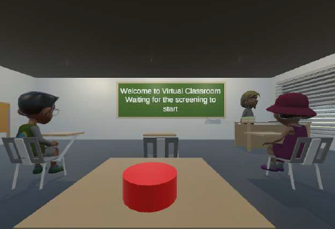
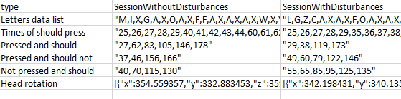
The experiment
The virtual classroom test
Test result file example
The system checks four parameters:
Response accuracy -‘Pressed and should’
Commission errors -‘Pressed and should not’
Omission errors -‘Not pressed and should’,
Head movements

Slide 12
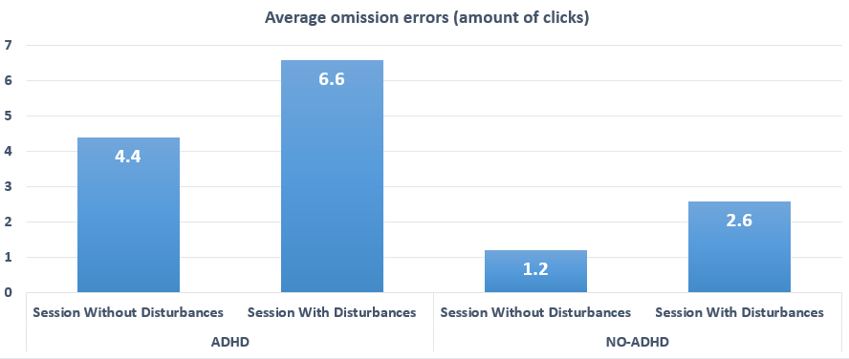
Data analysis
We conducted an initial analysis in order to differentiate between the two studied groups.
During the analysis, we found that other parameters are derived from the given results.
We averaged the parameters so that we could look at the difference between them in a better way.

Slide 13
Data preprocessing
The experimental results were raw, so we calculated a unique size for each parameter.
Model training parameters:
-Omission errors -Commission errors -Response accuracy -Response time average -Head rotation vector size Average

Slide 14
Model training with XGBoost algorithm
The model we built is of a classification type.
Classification is a supervised learning task. which includes defining labels for input data based on their attributes.
The two groups are labeled as 'ADHD' and 'No-ADHD'
We created a model that learns from labeled training data and predicts the class labels of a new subject based on its feature values.
XGBoost machine learning model- suitable for our problem and data.

Slide 15
XGBoost algorithm
01
02
XGBoost is a decision-tree-based Machine Learning algorithm
XGBoost is suitable for classification tasks
XGBoost
03
04
XGBoost is an optimized gradient boosting algorithm using parallel processing, handling missing values
The algorithm optimizes a specific objective function, minimizing loss or error, and regularization to avoid overfitting.

Slide 16
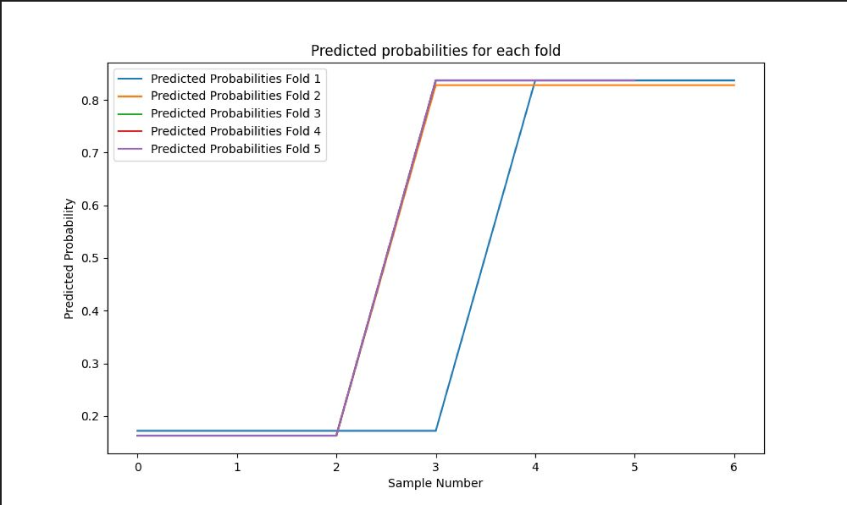
Training result

Slide 17
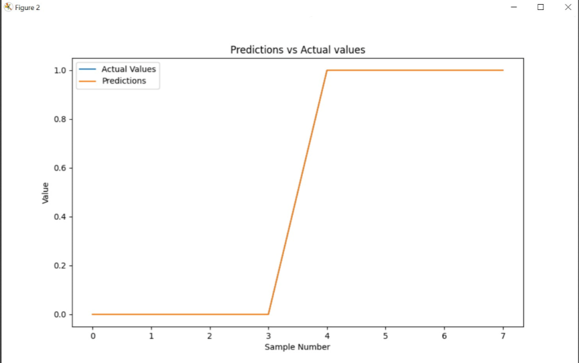
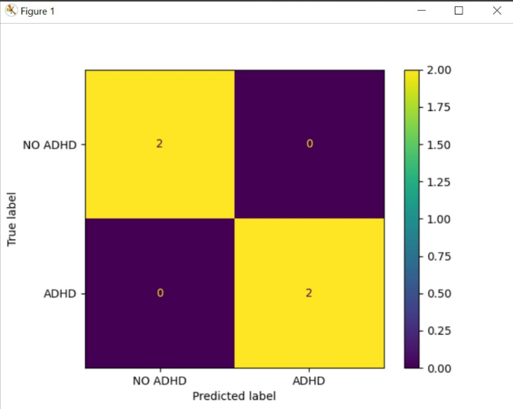
Testing result
Notes:
The following two images represent to us the results obtained by our model with the help of the algorithm.
We have two groups of subjects: one group that represents people with ADHD and the other group that has people without ADHD.
We trained the model on three files from each group and predicted the remaining two in each group.
We can see that, indeed, in the confusion matrix, we got an accurate swing, and also, in the prediction graph, we realized that the graphs are converging, but this can also indicate overfitting.
In advance, we considered that more than the number of files would probably be needed for learning. It is essential to know that the results are not the most accurate because of this, so for future work, they will have to add many more subjects to get more accuracy in diagnosing ADHD.

Slide 18
Result & Sample

Slide 19
Result
2
1
Sowtware developer tool
ADHD screening tool
model that classifies the subject, but not with 100% accuracy
An effective tool for a software developer who can add more test results and continue to train the model on larger data and thus make the results more accurate
3
4
ADHD expert tool
Student information system
Providing information about the nature of the disorder for the subject.
a system that shows ADHD diagnostics experts the significant differences between the results and thus provides them a tool for simulation results analysis, help in the process of decisions making, and for research in the field

Slide 20
Testing Process
During the project, we performed several tests.
We tested the external system that provides us with the subjects' data.
For example, one of the tests was to see that the data was received correctly.
In addition , we also performed a test on the user interface to see that the flow in the interface does take us to the goal. For example, suppose we did not select a user on the login screen and click continue. In that case, a message will pop up to the user that no user was selected.

Slide 21
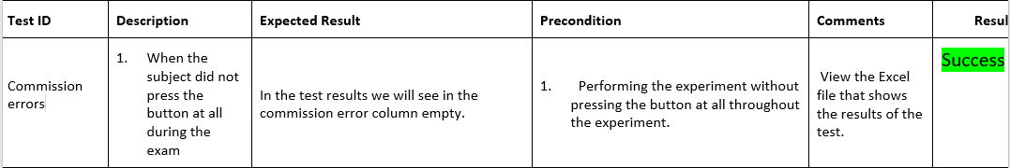
Example of testing

Slide 22
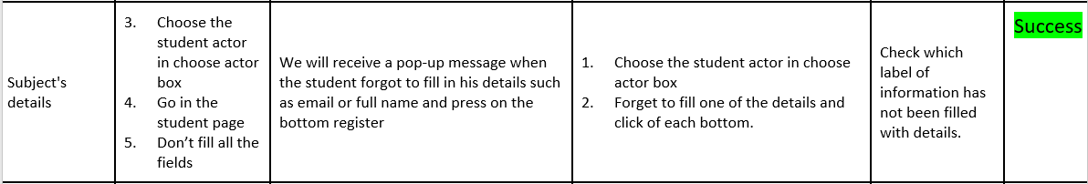
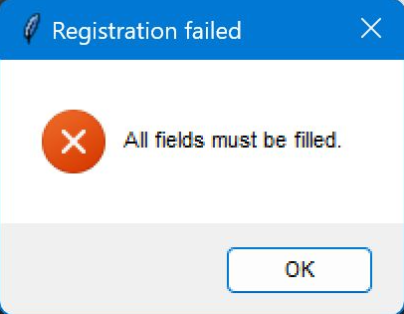
Example of testing

Slide 23
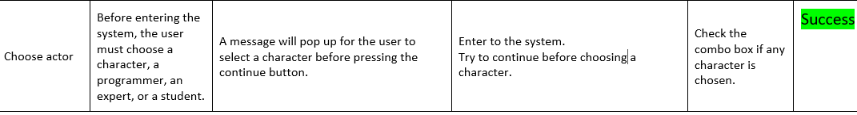
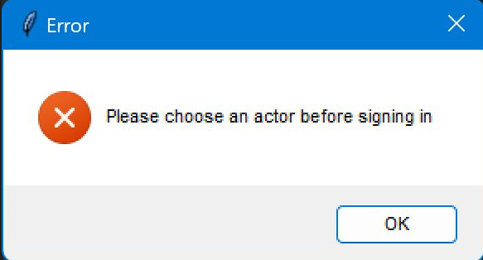
Example of testing

Slide 24
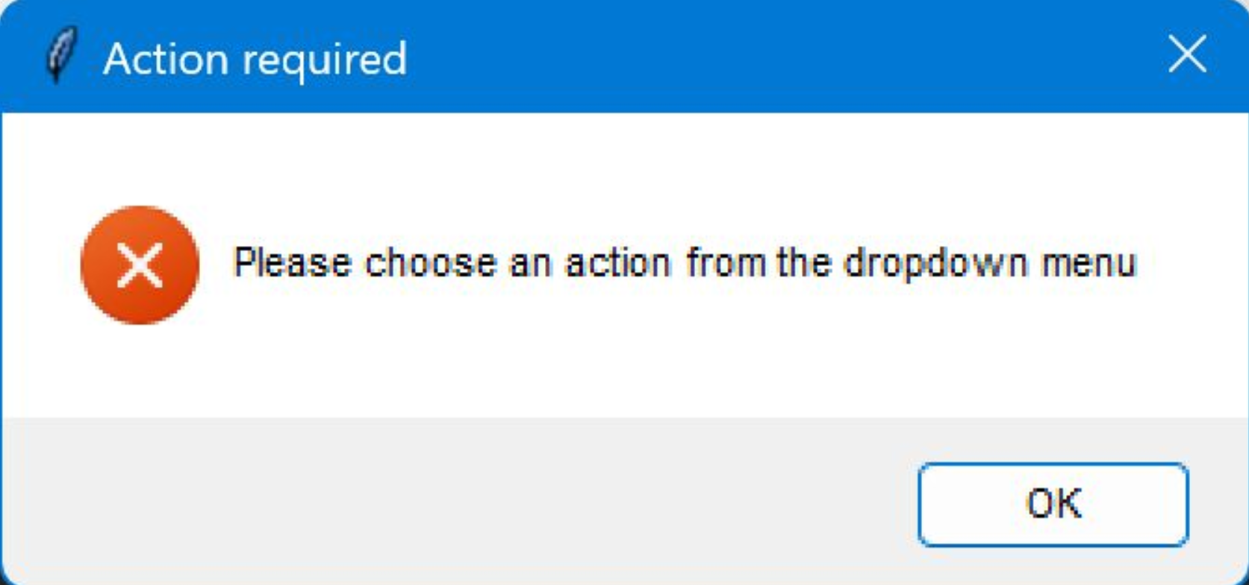
Example of testing

Slide 25

Sample

Slide 26
Challenges
1. At the beginning we had difficulty scheduling a Zoom meeting with the students who developed the system we used to collect the data for the model. Dependence on them slowed us a bit, but they helped us and we managed to get what we needed.
2. Using new systems - working with systems like Unity and VR required us to learn them during the semester.
3. Timeliness - we are both students in the last semester of our degree and also work every day, so the combination of all our tasks and responsibilities at the same time was challenging for us.

Slide 27
Thanks!
ANY QUESTIONS?

